Slide 1
RESEARCH TOPIC 5G network : Vehicular Network Security
Presented by MUHAMMAD ISHFAQ
REG_ID:220328

Slide 2
RESEARCH TITLE: 5G Network: Attacks on vehicular adhoc network and mitigation

Slide 3
Introduction:
AS high growing rate of technology, there is a need of advanced transportation system that should be cost friendly as well as completes future needs of people.
There should be an interaction b/w driver , vehicle and road environment.
Thus in this scenario autonomous onboard devices are complemented by wireless communication.
Thus these devices are vulnerable to attacks like(forgery, DoS, and false reports, malevolent)

Slide 4
RESEARCH PAPERS:
Year | Title | Proposed problem | proposed solution | limitations
2021 | Machine Learning for Securing SDN based 5G Network | securing the SDN controller targeted by DDoS attacks | Mitigation technique by training model of ML | Attacks done by using dynamic threshold cannot be detected
2020 | CONSIDERATION ON AUTOMATION OF 5G NETWORK SLICING WITH MACHINE LEARNING | User requires authentication everytime he uses any service | Novel authentication technique that satisfies 3GPP | SYSTEM is immune to replay attack ,which uses time stamp report.
2018 | CONSIDERATION ON AUTOMATION OF 5G NETWORK SLICING WITH MACHINE LEARNING | Manual authentication was required to user different services | 5g network slicing phenomenon | Did not allocate & adjust computing & network resources on service reqirements.
2019 | Dynamic Threshold for DDoS Mitigation in SDN Environment | Ddos attack on SDN environment |  | No limitation it can detect all ddos attacks & mitigate them

Slide 5
RESEARCH PAPERS:
year | Title | Proposed problem | Proposed solution | Weaknesses
2020 | An Enhanced Authentication Protocol based Group for Vehicular Communications over 5G Networks | The AKA mechanism proposed by 3GPP for 5g is unable to manage many devices. | lightweight authentication protocol based group for vehicular communications over 5G networks that follows the framework of 5G-AKA | It hs no weakness as proposed by the author.It can detect & block redirection, DoS, MITM and replay attacks.
2022 | Comprehensive Review on Misbehavior Detection for Vehicular Ad Hoc Networks | Misbehaviour in VANET’s(attacks are forgery, (DoS), and false reports, malevolent | Author has proposed cryptographic solution
2021 | Intrusion Detection System on IoT with 5G Network Using Deep Learning | Attacks on iot devices | Autoencoder based novel deep learning technique | Computational resources were used largely.
2018 | Machine Learning Techniques used for the Detection and Analysis of Modern Types of DDoS Attack | Anamolous behavior of network traffic. | Machine learning tool WEKA version 3.8 was used for detection and training of data sets | Attacks on osi and transport layer were neglected

Slide 6
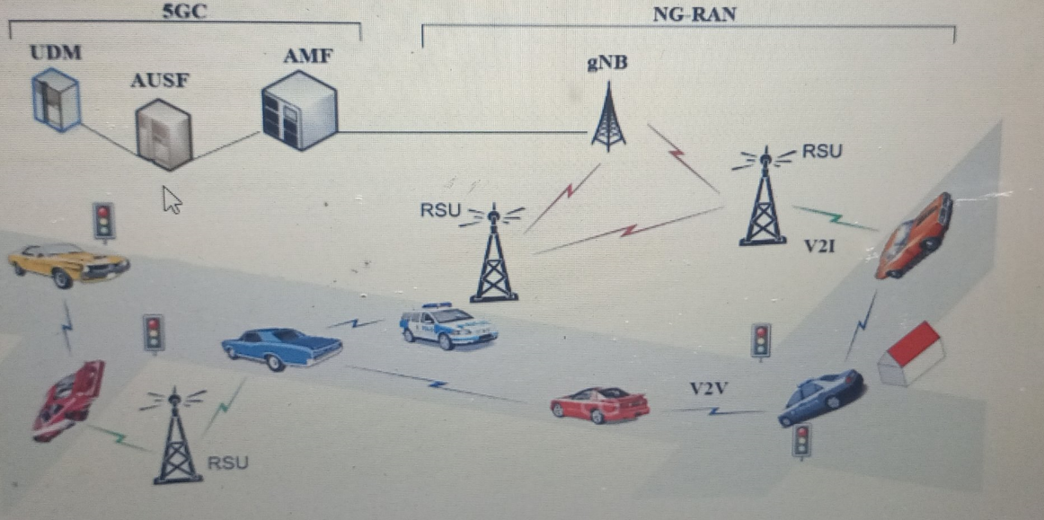
Vehicular network

Slide 7
PROPOSED PROBLEM:
The vehicle can also be attacked like MITM(man in the midlle) this means that attacker stops the services of the vender and client cannot attain his /her services, Redirectional attack means that destination of client is compromised and sometimes their rout towards destination is changed so that they can be extra CHARGED OR SOME OTHER FUNCTIONS. Sign change attack means signs that are along side of the road are changed for to create the chaos among peoples.

Slide 8

IMAGE of chang in sign

Slide 9
THANK YOU

